Slide 2
Amplified Digital (AD) is a full service digital agency focused on strategic digital marketing, creative services, media planning and consulting. Born and bred out of a traditional media company, (the St. Louis Post-Dispatch) our Agency and its leaders understand ALL types of media, and can help strategize to incorporate digital with your traditional media placements to maximize your ROI.
At Amplified Digital, our #1 priority is your success, which means we first take the time to LISTEN to what your business goals and objectives, so that we fully understand your project before moving forward. From there, we investigate and strategize the best course of action, including campaign messaging, creative, and content, timeliness, and execution – working to navigate your team throughout the process to help you meet and exceed your company’s KPI’s.
We’re Full Service. Our team of digital marketing experts are focused on developing strategic marketing plans, creative services, & consulting to help grow your business and accomplish your goals.
We’re Local. With teams in top U.S. markets, Amplified Digital is a nationwide digital agency. We work with brands large and small across 46 markets in the United States, as well as with other agencies and traditional media companies, serving as their digital marketing and solutions vendor.
We’re Premier Google Partners and Bing Accredited Professionals – which means our team is held to the highest quality standards, get early access to new products, and participate in trainings.
We’re Resourceful. We have access to thousands of websites through major exchanges to allow you to reach the right person at the right time with your message.
We’re Dedicated. Your team includes a Partner Development Manager, Account Executive, Media Planner, Account Coordinator, Success Manager and a Fulfillment Manager who will work with you on your comprehensive marketing strategy.
We’re Transparent. Here at Amplified Digital, we’ve got nothing to hide. See the numbers behind our campaign strategies and recommendations with transparent reporting on all of your marketing efforts.

Slide 3
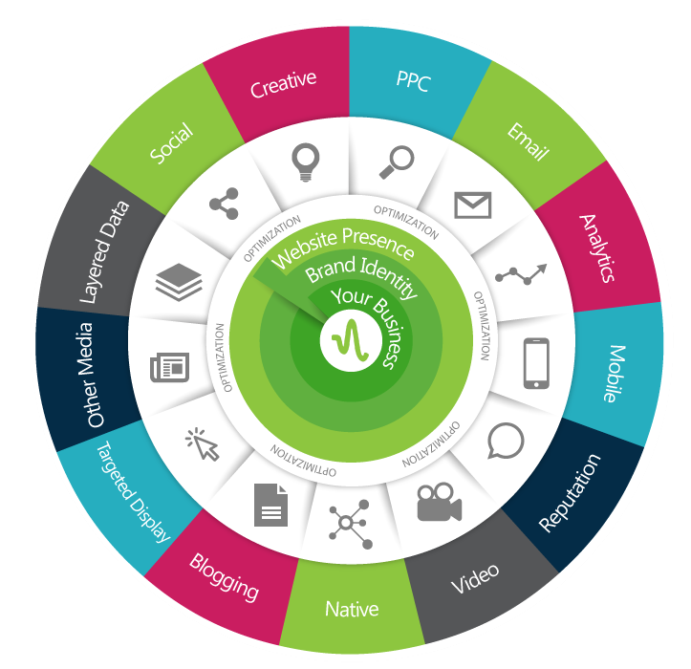
{
Amplify Your
Brand
Digital Presence
Brand Recognition
Audience Targeting
Lead Generation
Social Engagement
Content Marketing

Slide 4
OUR PROCESS
CAMPAIGN STRATEGY
CAMPAIGN COORDINATION
CAMPAIGN FULFILLMENT
REPORTING & OPTIMIZATION
Our campaign Strategy team works directly with you and your account exec to understand your goals and timelines, and develops a campaign with proper placements to reach your goals, and thoughtful messaging.
Campaign Coordinators interface between your Strategist and our Campaign Management team to ensure every aspect of your campaign is in place to reach your goals effectively, helping to tie all elements of your campaign together.
Our team of Campaign Managers work diligently to develop and launch your campaign with your goals and tracking mechanisms in mind. Throughout the campaign, they continually monitor and optimize for lower costs and higher conversion rates.
Once your campaign has hit timed milestones, your reporting will be analyzed, and further optimization tactics (both placement and budgetary) will be put into place, ensuring we’re reaching your KPIs. You’ll also receive access to our 24/7 reporting dashboard.

Slide 5
“Best in the Biz” DSP
(Demand Side Platform)
SCALE
TECHNOLOGY
DATA
QUALITY
DIRECT ACCESS
When working with Amplified for your digital advertising, your campaigns will run in the most effective ad positions, and we’ll work to keep your costs as low as possible. Plus, you’ll benefit from our DSP’s direct integrations, with more than 70 inventory sources spanning all channels, devices, and regions.
With our DSP’s unique bid factoring methodology, we offer the most advanced optimization capabilities in the digital marketplace. We can narrow targeting by time of day, temperature, ad format, recency and more. We create campaigns that are informed by more data than ever before, leading to unprecedented campaign performance.
Data is the fuel to every targeted campaign. When working with Amplified, your campaign has the ability to apply data from everything POLK to Discover Card, and so much more. Plus, we’re able to upload FIRST party data and enrich your campaign through existing connections with IP targeting and customer match With this much data at our fingertips, it’s no wonder our campaigns are so successful.
Our DSP offers total brand safety through quality solutions, allowing you to buy with confidence and ensuring your campaign will be delivered to humans, not bots. They identify non-human traffic patterns and institute immediate platform-wide blocks on suspicious traffic through proprietary algorithmic fraud detection and blocking models.
Amplified Digital has DIRECT seats on this platform – cutting out the middle man that most companies tout – while keeping your costs low and optimization and campaign performance top of mind. Through our direct access, we have the ability to manage Display, Audio, Video, and Native Campaigns through ONE channel.

Slide 6
AMPLIFIED SOLUTIONS
These are just a handful of the tools at our fingertips to help reach your goals

Slide 7
OUR GUIDE TO A COMPREHENSIVE MARKETING STRATEGY
Leveraging Earned, Owned & Paid Media
ADVERTISING
Pay Per Click
Targeted Display
Targeted Video
Targeted Audio
Targeted Email
Content Promotion (Native)
Site Specific & Direct Site
Sponsorships
Contests
SMS
OTHER ADVERTISING
Billboards
TV Commercials
Radio
Print
Direct Mail
ENGAGEMENT
Social Engagement
Social Shares
Mentions
Reposts/Retweets
Business Reviews
Blog Comments
eNewsletters
SEO Ranking
EARNED MEDIA
PAID
MEDIA
OWNED MEDIA
SEO, Blogging and Brand Content Drive Earned Media & Traffic
OWNED PROPERTY
Responsive Website
Social Channels
Business Listing Profiles
Blog & Company “Voice”
Gain more exposure and build authority to your website with SEO and PPC

Slide 8
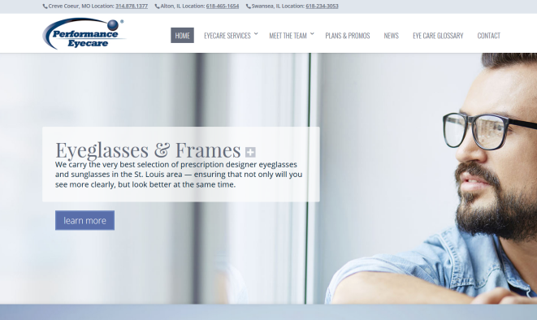
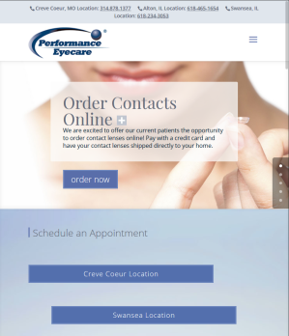
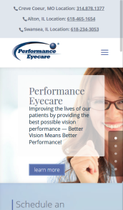
WEBSITE DEVELOPMENT
OWNED
CUSTOM DEVELOPMENT
Amplified will design and create an affordable, professional, and informative website that is responsive on all devices and customized for your business.
HOSTING & MAINTENANCE
Our hosting program offers 100% hack-free security, giving you piece of mind that your site is safe and malware free. Our team will work with you to keep your website content fresh and up to date with our website maintenance programs.
CONVERSION PAGES
Convert your social media followers, email subscribers and ad campaign clicks into sales, with a landing page designed
to convert leads into customers.
ANALYTICS & REPORTING
Gain valuable insights with rich reporting to deliver data about your website visitors and their behaviors on your site.

Slide 9
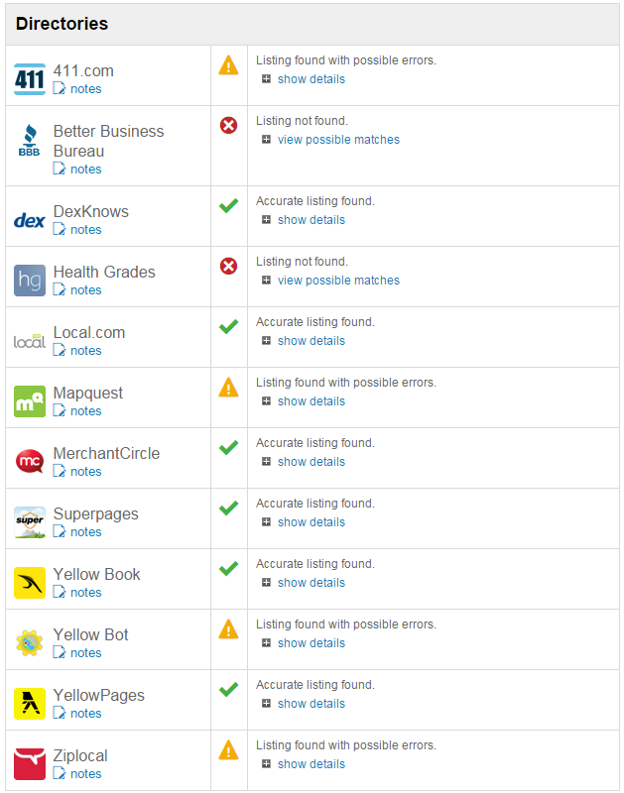
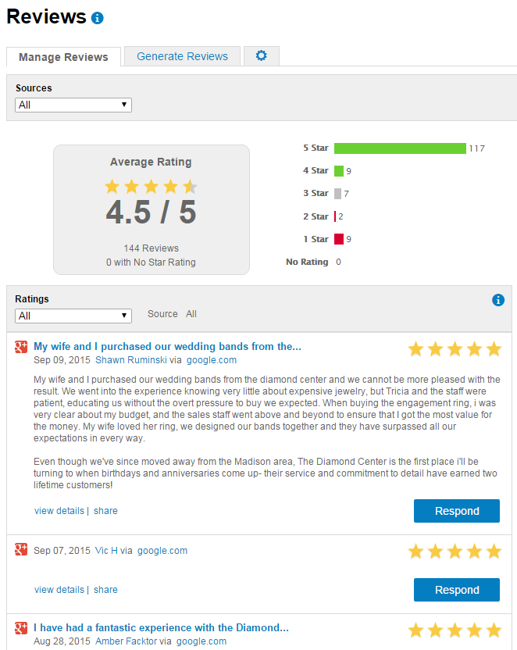
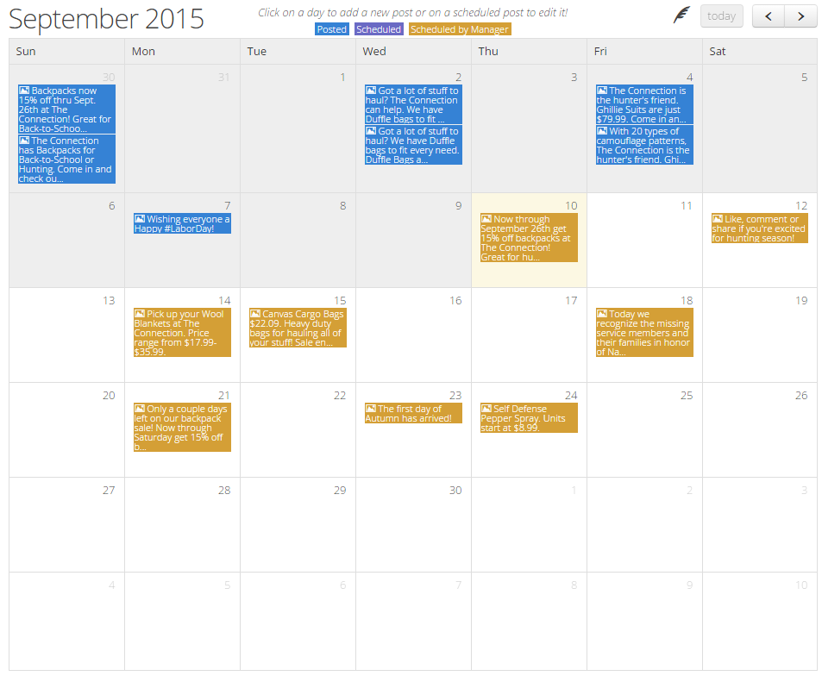
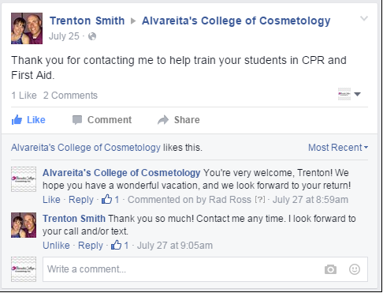
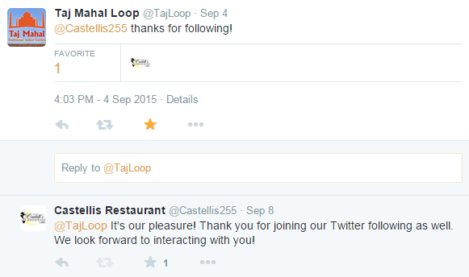
SOCIAL, CONTENT & REPUTATION
OWNED & EARNED
SOCIAL MEDIA MANAGEMENT
We’ll create your profiles and write your company’s status updates, matching your brand’s voice so that your profile is engaging and posting new content, even when you’re too busy! We’ll proof them to you prior to posting.
REPUTATION MANAGEMENT
Verify the accuracy of your business listings across review sites, directory sites, and social networks. Compile mentions, check-ins and reviews from sources including news sites, blogs, and social networks, and highlight the most positive and negative mentions using our system’s automated sentiment analysis.
CONTENT / BLOG COPYWRITING
Stay engaged with your customers and reach new ones with the creation and publishing of unique, optimized content, blog posts and imagery about your business
SOCIAL CONTESTS
Gain new customers and build leads with a social contest or promotions. We’ll help make it successful by leveraging targeted audiences to drive engagement and conversions

Slide 10
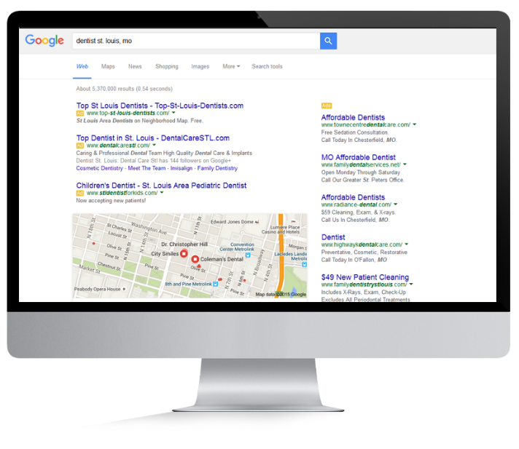
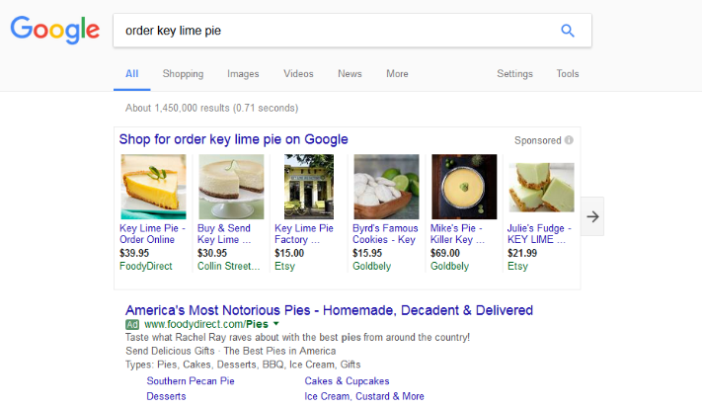
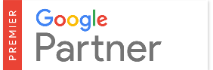
SEARCH
EARNED & PAID
SEARCH ENGINE OPTIMIZATION (SEO)
Bring your website to the first page of search engine results by enhancing the content and keyword frequency, meta data, link structure, and authority of your website, as well as building and enhancing your company’s external referrers and social/directory profiles.
PAY PER CLICK (PPC) SEARCH ENGINE MARKETING
Reach people who are ready to make a decision by placing your company at the top of search engine results pages for keywords relevant to your products and services. Geo target to focus in on the areas most important to your business.

Slide 11
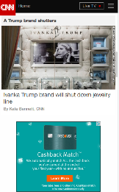
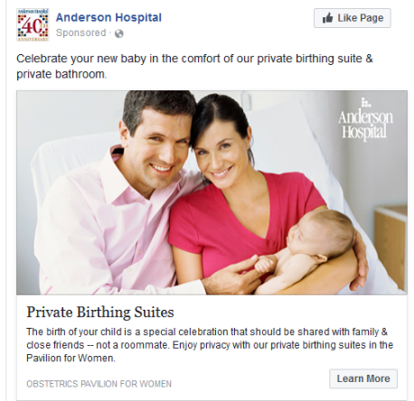
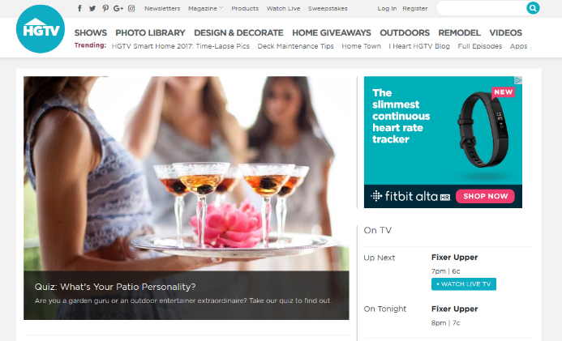
AUDIENCE TARGETED DISPLAY
PAID
AUDIENCE TARGETING
Target specific audiences via demographics, keywords, site category, topic and behaviors. Geo-target by country, state, county, DMA or zip code, and can specify mobile/tablet only if desired. Includes premium above the fold placements.
WEBSITE RETARGETING
Retarget consumers that have visited your website with display ads and messages wherever those consumers go online.
NATIVE ADVERTISING
Improve your organic ranking while driving conversions using content strategically placed on websites, targeted to the audience you want to reach.
IP TARGETING
Target incredibly specific households, businesses, or individuals based on their address, and show your ads while they browse the web.
WEBSITE LOOK-A-LIKE TARGETING
Target consumers that ‘look like’ the people that are already visiting your website.
TARGETED SOCIAL MEDIA
Reach your target audience where they already spend time online via Facebook, Instagram and LinkedIn ads. Target audiences by job title or function, interests, life events, and behaviors.
MOBILE LOCATION TARGETING
Target consumers on mobile apps based on a specific physical location they have visited using GPS technology.
MOBILE GEO-FENCING
Target consumers within a specific geographic mile radius around a geographic location.
ARM-A-LOT NETWORK
Target consumers on a network of websites that allow gun, ammunition, and hunting accessory advertising.
We’ve Identified 96,406 Devices Matching:
Age: 35-55, male and female
In the St. Louis area
Who are: College Educated, with a HHI of $100K+
Interests: Shopping, Vacationing, Spas, Golf and Resorts
Opportunity: 2,313,748 available impressions

Slide 12
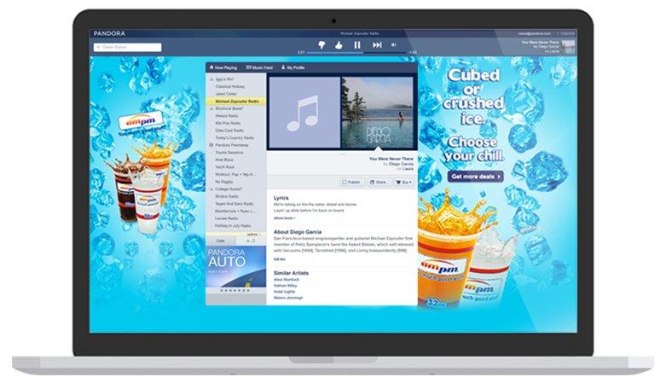
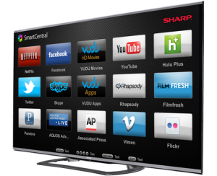
TARGETED STREAMING SERVICES
PAID
YOUTUBE TRUEVIEW
Pre-Roll Videos on YouTube, with 80%+ view ability across desktop, mobile and tablet. Target your audience further by country, state, county, DMA or Zip code.
CONNECTED TV (CTV)
As cable and satellite subscriptions decline, users pick up smart devices. Reach these cord cutters on Smart TV’s, tablets, and mobile devices with your video advertising, just like commercials on TV.
PROGRAMMATIC VIDEO Reach viewers streaming video content with your :15 or :30 video or commercial spot!
PROGRAMMATIC AUDIO
Reach listeners on audio streaming services with your :15 or :30 radio spot! Most platforms include a companion display unit giving visual support to the audio messaging.

Slide 13
EMAIL & LIST MATCHING SOLUTIONS
PAID & EARNED
TARGETED EBLASTS
Reach highly targeted audiences right in their inbox with our permission based, targeted email marketing program. Layer targeting data sets such as gender, race, age, income, location, hobbies and lifestyle interests.
CUSTOMER MATCH REMARKETING
Boost the effectiveness of your campaign by matching your email database up with users on Facebook to make an impact in their newsfeed.

Slide 14
REPORTING & TRACKING
Amplified Digital doesn’t stop at just driving traffic, we focus our attention and optimization towards what happens AFTER the click.

Slide 15
CAMPAIGN REPORTING & OPTIMIZATION
Amplified Digital offers real time reporting so you can access your campaign reports at any time to see how they are doing. As part of our campaign strategy, our team will perform ongoing campaign optimization to ensure we are investing your dollars wisely. Some of our measurement & optimization tactics include:
View Thru Conversions (VTC) track how many people visited the site AFTER seeing the ad but not clicking.
Conversion Tracking shows us how many people took a measurable action AFTER seeing the ad. This allows us to optimize your campaign for the best performing ads based on the conversions. Trackable information includes phone calls, ecommerce check out, form fills, video plays, downloads, and more!
Keyword Adjustments – (PPC) after the campaign is running, we utilize the search terms report for new keyword strategies and ideas (both positive & negative), and optimize your campaign towards displaying the keywords that are converting best.
Creative & Split Ad Testing – with split ad testing, 2 ads are created for a placement. These ads run against each other until a statistically significant result is reached. The losing ad is disabled and another new ad is created so that the process continues.
Bid/Budget Adjustments – campaign and placement bids/budgets are set and adjusted to ensure the maximum level of control. We use a combination of automated and manual bidding techniques to ensure that we are maximizing the ad budget to deliver desirable conversions. budgets are increased and decreased as necessary and shifted between campaigns based on performance to ensure that we are maximizing the campaign budget to deliver conversions for the full length of the campaign.
Networks/Data Providers – performance on different websites, and by different data providers is adjusted as necessary if/when relevant data emerges.

Slide 16
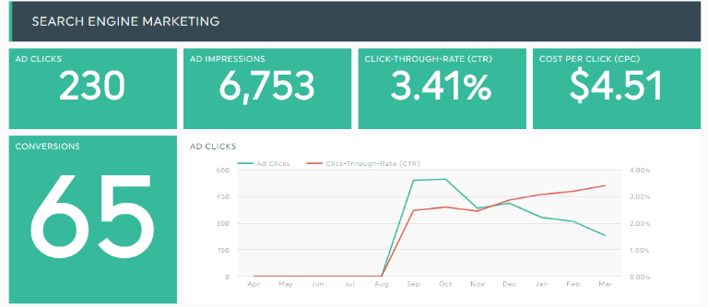
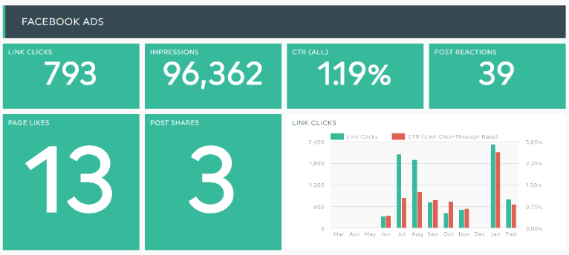
CAMPAIGN REPORTING DASHBOARD
Metrics based on each placement
Specific metrics for each placement type
Total Conversions for each Placement
Placement performance trend
Amplified’s “Always On” reporting dashboard lets you see the real numbers behind your campaigns – including the standard metrics like impressions and clicks – all the way through to conversions and view through conversions.
View Thru Conversions (VTC) track how many people visited the site AFTER seeing the ad but not clicking
*Login access to the reporting dashboard is available 24/7. Campaign reporting is updated 1x per day.

Slide 17
BENCHMARKS & CASE STUDIES
Amplified Digital is highly experienced when it comes to digital marketing for the medical industry

Slide 18
INDUSTRY BENCHMARKS
For 2017, our internal benchmarks for the medical industry compared to overall industry benchmarks are as follows:

Slide 19
CASE STUDIES
Bariatric Surgery
Overview & Challenges
A hospital was looking to increase traffic to and increase the number of conversions (requests for information, seminar registrations) coming from its newly launched Bariatric Surgery website.
Solution
Having a new website, we knew it would take some time before client would begin to see a large amount of organic traffic. In order to begin immediately driving high quality traffic, we launched a PPC campaign targeted at users searching for information that matched the content the newly launched website was offering. Due to nature of Bariatric Surgery (users typically conduct quite a bit a research prior to committing to the procedure), a supplemental remarketing campaign was launched as well. This remarketing campaign allowed us to capitalize on the extended research process by giving us an opportunity to get our message across to potential patients as they took their research to other websites.
Results
The campaign generated over 1,900 new visitors to the site; 21.40% of whom either called the hospital for more information, requested more information via the website, or signed up for a seminar.

Slide 20
CASE STUDIES
Urgent Care
“We've been working with Amplified for almost 5 years. Through Amplified we have been able to experience significant growth in patient volumes and revenues.
They are continually fine tuning and searching for ways to improve to benefit our business. I would highly recommend them for any business searching for growth.”
Overview & Challenges
Back in 2013, a new urgent care office was looking to get their name out there, expand their patient counts, and grow their business. Fast forward to 2017, and they are seeing faster growth than any other medical business in the area, and have grown to 5 locations.
Solution
Amplified partnered with the new urgent care to develop a patient-focused website, geared towards meeting the needs of urgent care – and helping patients navigate their illnesses and ailments. After the site launched, we began an extensive PPC campaign to help boost the traffic to the site, while working on the organic traffic. Once the client had a stable patient base and a few years of success, he wanted to begin branding himself in new areas for non-urgent patient types, so we launched an audience targeting campaign to help spread the word.
Results
In 2017, the company opened its 5th location. Our campaigns continue to meet and exceed the client’s KPIs and perform above industry benchmarks.
2017 data shows a 10.3% increase in CTR’s YOY, an 18.1% decrease in cost YOY, and a 57.5% increase in conversions YOY.

Slide 21
CASE STUDIES
Regional Healthcare Group
Overview & Challenges
The clinical division of a local university’s school of medicine, consisting of over 500 physicians, had two major challenges. First, they needed to promote the brand as a whole and its unique position in the community as a network of highly trained physicians working together to provide excellent care for patients with a wide variety of complex medical conditions. Second, they wanted to promote individual departments within the group, and highlight the physicians who operate within these as leaders in their respective fields.
Solution
Search Engine Marketing (PPC) campaigns (with which they had no previous experience) were launched to complement their already running display/social media campaigns. This would allow the group to speak directly to a diverse user base as the users searched for exactly what the group is offering. Instead of launching campaigns for all departments simultaneously, we worked with the client to develop a system of rolling out departmental campaigns a few at a time. Starting with one of the group’s larger departments, the campaign has grown to include twelve different departments. While all campaigns share the goals of promoting the brand and the group as leaders in their respective fields, they each also have their own unique goals. Some reach out to the local community to highlight the group as a destination for your more common healthcare needs, while other others target the global community highlighting the group’s expertise in highly specialized fields.
Results
Overall website traffic has increased by 75.45%. Due to ongoing optimization efforts, valuable website actions increased significantly as well; the number of on-site searches for physicians increased by 32%, while usage of the online appointment request tool increased by 71%.

Slide 22
THANK YOU FOR YOUR TIME
Please feel free to reach out should you have any questions.
Amplified Digital Agency, LLC
900 North Tucker Blvd. 4th Floor St. Louis, Missouri 63101 314.884.2080
Jolene Sherman VP of Digital, Lee St. Louis JSherman@amplifieddigitalstl.com 314.340-8583
Account Executive
Digital Marketing Manager

