Slide 1
AGENCY CAPABILITIES DECK
2020

Slide 2
WE ARE
AMPLIFIED

Slide 3

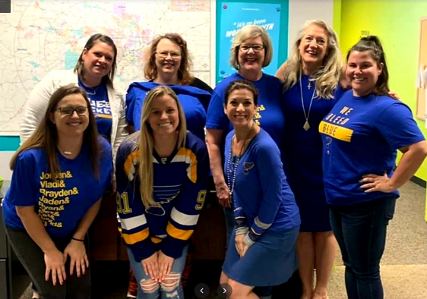
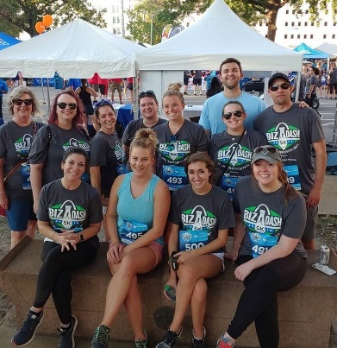
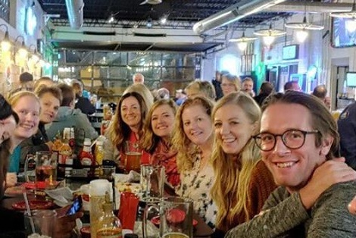
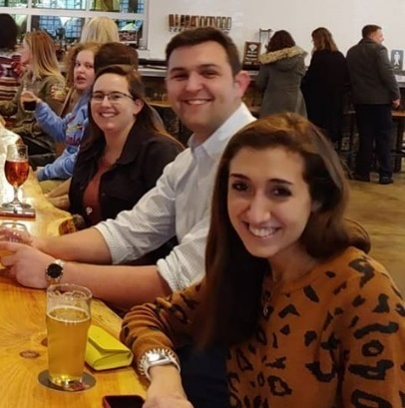
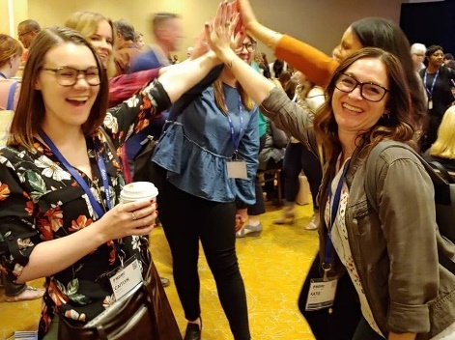
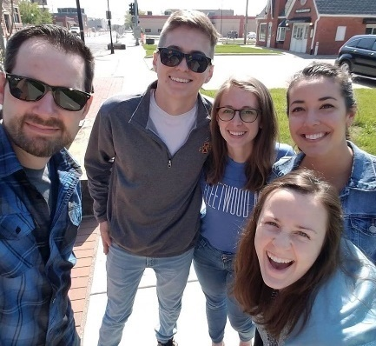
At Amplified Digital, we have a four step process that has proven successful for our clients time and time again.
BE TRANSPARENT
Share audience data, research and performance metrics, even if it exposes weaknesses (or opportunities), ensuring transparency throughout the relationship and building a strong foundation for growth.
BE STRATEGIC
Build smart, data-driven marketing campaign plans – utilizing research, industry trends, and several thousand campaign learnings to reach ideal audiences.
BE CREATIVE
Design powerful campaign messaging and creative elements that aim to not only resonate with targeted audiences, but inspire them to take action – connecting with brands in meaningful ways.
BE BOLD
Develop sound campaign conversion goals and benchmarks to measure the campaign against. Continually optimize each placement’s targeting, budget, and creative to drive growth & maximize goal conversions.
WE’RE
TRANSPARENT
STRATEGIC
CREATIVE
BOLD

Slide 4

NATIONAL RESOURCES MEET LOCAL EXPERTISE
When you partner with Amplified Digital, you’re working with a NATIONAL digital agency who understands LOCAL audiences.
REPRESENTED BY
LEE ENTERPRISES IN
77 MARKETS
WITH A LOCAL PRESENCE IN 26 STATES
TEAM MEMBERS NATIONWIDE

Slide 5

130 YEARS OF AUDIENCE ENGAGEMENT & ADVERTISING INNOVATION
Providing local news, information and advertising in 77 markets in 26 states.
No other company can match the results we deliver through our agency products and services when paired with Lee Enterprises’ network of news websites, apps, newspapers, and niche publications.
350+
Weekly print & digital
publications
44 Million
Unique Visitors per month to
Lee’s News Sites
1.2 Million Newspaper subscribers

Slide 6






Our comprehensive group of marketing enterprises work together to meet your goals.
AMPLIFIED
DIGITAL
SUNNY MEDIA
AUTO AGENCY
HEALTH BRIGHT MARKETING
AMPLIFIED
FULL CIRCLE
AMPLIFIED
AG
AMPLIFIED
CONNECT
AMPLIFIED
INSIGHTS
BRAND AVE.
STUDIOS

Slide 7

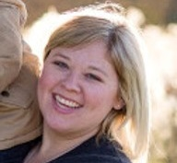
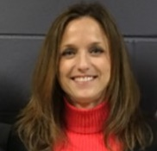
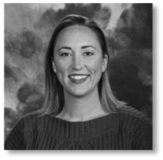
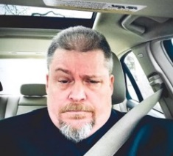
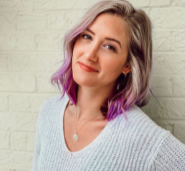
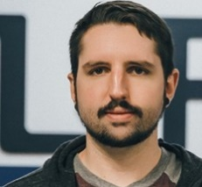
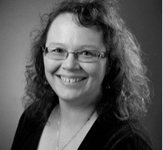
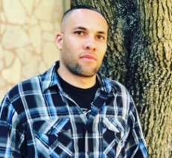
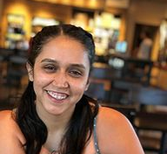
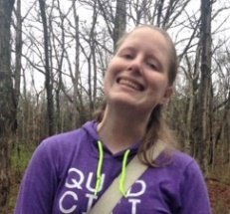
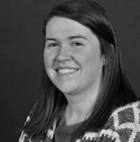
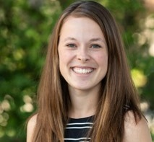
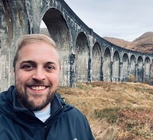
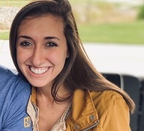
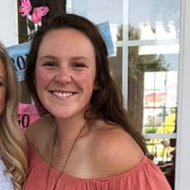
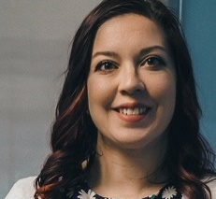
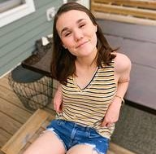
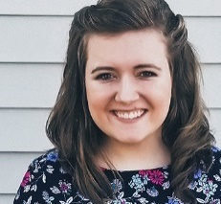
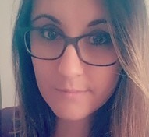
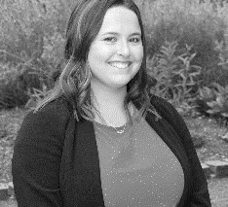
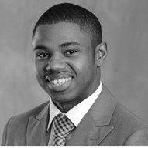

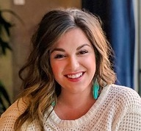
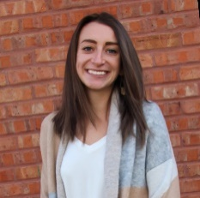
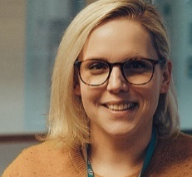
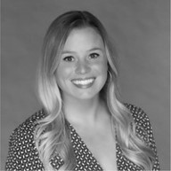
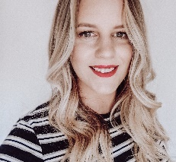
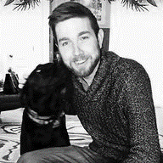
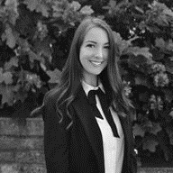
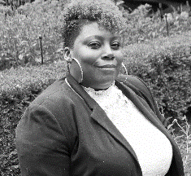
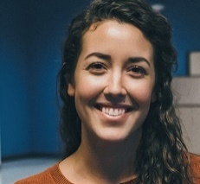
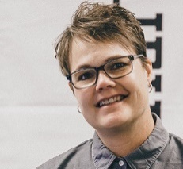
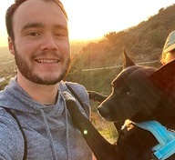
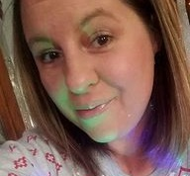
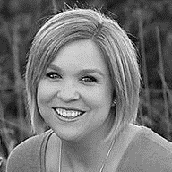
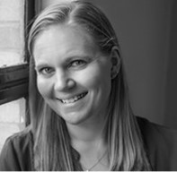
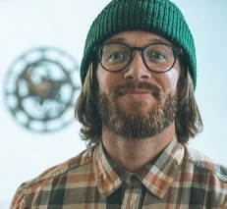
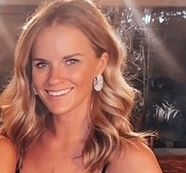
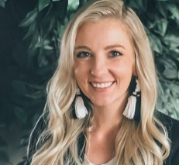
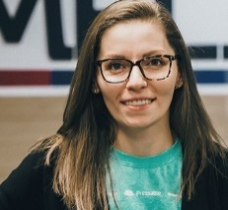
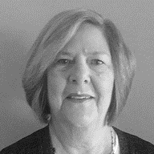

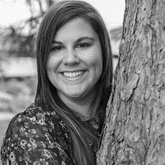
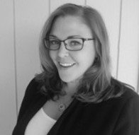
OUR TEAM
AN EXTENSION OF YOURS

Slide 8
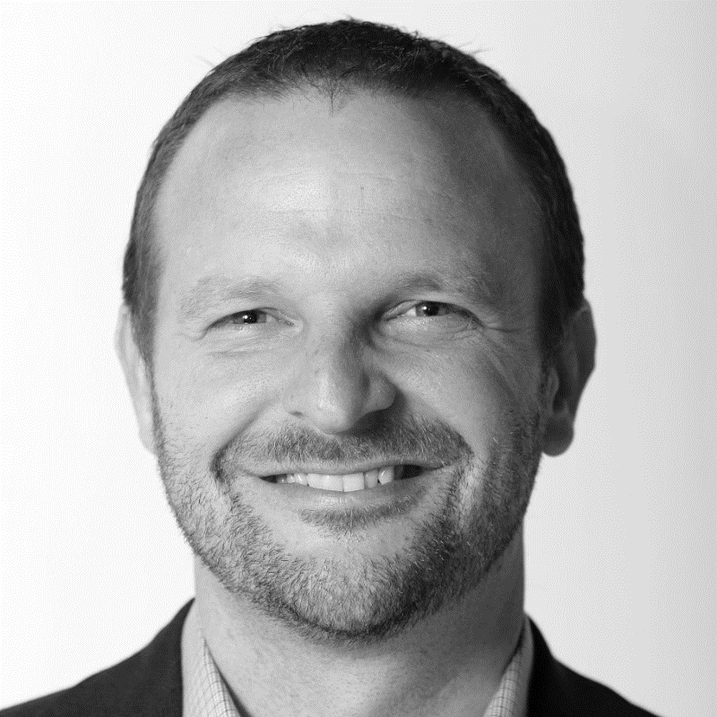
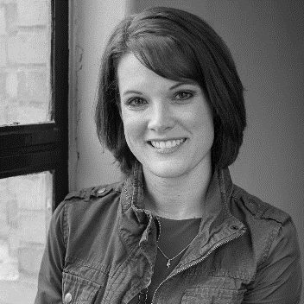









MEET
YOUR
TEAM
Our Leadership Team is comprised of many talented individuals, all focused on the growth and development of Amplified Digital and Lee Enterprises.
JOE BATTISTONI
VP Local Advertising Sales
JOLENE SHERMAN
VP Digital Sales & Agency Strategy
SHELLI GROSHANS
Amplified Office Manager
AMANDA MCGINNIS
Managing Director, Amplified Digital
ANDREWS COLON
Senior Director Agency Strategy
JOHN LICH
Regional VP of Sales
CLARITY PATTON
President of Sunny Media Group, Inc.
EMILY TINTERA
Director, Amplified Connect
BEN BLACKWELL
Director, Local Digital Sales Strategy
LAURA IWANSKI Director, Client Development
ROBIN GRUEN
VP Content Strategy
Brand Ave. Studios

Slide 9



MEET
YOUR
TEAM
Our Vision Pre-Sales Team supports and empowers our front-line teams by offering a simple platform to plan and propose digital audience solutions for small-medium sized businesses, with a consistent go-to-market approach on every single call, 10x quicker turnaround time, and integration of our audience solution portfolio.
BENJAMIN BLACKWELL
Director, Local
Digital Strategies
RILEY HALE
Vision Success
Team Manager
BRIAN LIGHT

Slide 10




MEET
YOUR
TEAM
Our Client Development Team offers strategic campaign strategy development, providing research and working with client goals and industry benchmarks to develop robust media plans and campaign strategies to help clients achieve business goals.
LAURA IWANSKI
Director, Client Development
ERICA MAURER
Client Development Manager
MAUREEN ZWILLING
Client Development Manager
TONYA CHAMPA
Client Development Manager
KEVIN HAINES
Client Development Strategist
MACKENZIE LEHMEN
Client Development Strategist
SOPHIE MITCHELL
Client Development Strategist
CHRIS WILLIAMS
Client Development Strategist

Slide 11


MEET
YOUR
TEAM
Our Insights Team supports clients and their marketing campaigns by providing and interpreting data to determine the optimal audience and the best marketing platforms to reach them.
LAURA IWANSKI
Director, Client Development
MELISSA FIX
Data Research Manager
ZACH BRYANT
Market Research Analyst
MARK BENSON
Cartographer &
Geospatial Analyst

Slide 12















MEET
YOUR
TEAM
Our Client Success Team engages with client campaigns from inception, working with both clients and internal teams to provide strategic analysis on campaign and tactic performance, measuring up against benchmarks, and developing optimization strategies to reach client business goals.
KATIE BINGHAM
Director of Client Success
CAITY HEPLER
LYNDSEY EAGLE
ALEXA SHELTON
DONNA FOX
SARAH GEISEN
ERICA HURT
KIMBERLY RICHEY
JACOB MASEK
PAIGE WILDER
JILL MOORE
CHAS ORTMAN
MATT SUCHAN
ALLISON PENTONY
TAYLOR AWALT

Slide 13














MEET
YOUR
TEAM
Our Campaign Managers are experts in their respective tactics and platforms, working internally to monitor client campaigns for paid agency advertising – display, search, and social, according to best practice standards and work hand in hand with the Retention team to make optimization recommendations to campaigns.
KATIE BINGHAM
Director Fulfillment
KEAUNDRIA
MCROBERTS Fulfillment Team Manager
JOE
KERKHOVEN
Team Lead & Trainer
MADDY
WEISS
ALEXANDRA
FRANCO
ROXAN
CRABTREE
SUE
O’HOARA
KENNE
GOODE
MARY OSTER
ZACH
SCHOL
MELANIE, WOODFIN
DENISE
CARR
DARREN JONES
THOMAS MURRAY

Slide 14








MEET
YOUR
TEAM
Our Project Development Team provides project management, working with clients on presence development projects, including website development, social channel/profile management and online reputation development, gathering all necessary deliverables and requirements, and keeps all teams on target to reach client project goals and timelines.
ASHLIEJAEKE,
Director, Project Development
AMBER RAJCEVICH,
Project Development Manager
ANTHONY GIAMPAOLO
Web Strategist
CARA TAYLOR,
Project Support Specialist
NANCY FICHTER,
Project Specialist
ARIEL OLSON
ASHLEY ATOR
CARLOTTA DOOLEY
MARIAH RICHTMYER

Slide 15







MEET
YOUR
TEAM
Our In-House Website Development Team helps clients express themselves, build brands, and build and grow business online by developing and managing robust, device responsive websites that speak to the company’s products and services, working to ensure clients have a successful foundation online.
ASHLIEJAEKE
Director, Project Development
TRISHA JOHNSON
Lead Web Developer
LAURAELLIOTT
QA Specialist
STEVE WHITE
Web Technology Specialist
JENNELL BERGWALL
Senior Developer
KYLE ZIMMER,
Full Stack Dev.
MICHAEL WALLACE
TAVIS FRAZIER
JOE PATRICK
MICHAEL DELLAVECCHIA

Slide 16




MEET
YOUR
TEAM
Our Social Media, Reputation Management, and Search Engine Registration Team assists clients in developing a strong presence online through social profile, listing directory site and search engine profile creation and management– working to ensure consistency and accuracy, as well as engaging social content development and contesting.
ASHLIE
JAEKE
Director of Project Development
EMILY
MURPHY
Social Media & Reputation Supervisor
SAMANTHA
JACKSON
LINDSEY
WESSEL
JESSICA
LEE

Slide 17










MEET
YOUR
TEAM
Our Creative Team works with clients to develop creative concepts, branding elements, website mockups, and various other designs to drive action in audiences through multi-tactic marketing campaigns. Our Content Strategy Team builds and writes content strategies aimed at delivering SEO smart content for client websites, sponsored content and blogs.
ROBIN GRUEN
VP Content Strategy
Brand Ave. Studios
NINA HOSTE
Associate
Creative Director
ROMAN JOHNSON
Ad Tech Manager & Designer
BRIDGET
HENNESSEY
Designer
KATIE PIKE
Designer
JAKE REEDER
Designer
TADD IRVEN
Designer
JULIA POPENFOOSE
Designer
LIZ MASTERSON
Designer
KATIE PALMER
Content Manager
STEPHANIE DOTZLER
Content Writer

Slide 18





MEET
YOUR
TEAM
Our Future Development is achieved by multiple team members and managers working to develop strategic programs, distributing knowledge, managing current and potential partnerships, maintaining Amplified Digital’s brand image, setting up speaking engagements and sponsorship opportunities, and improving organizational structure and processes.
PAULA HUFNER,
Assistant
Transition Manager
MELISSA NEAL
Manager of Vendor
Relations
TRACY NELSON
Campaign Optimization
& Intelligence Manager
MICHELLE PONDER
Brand PR & Event
Sponsorship Manager
ANNA CROWE
Brand & Strategic Initiative Specialist
KELSEY MANCUSO
Strategic Initiative Specialist
MANDI HESSER
Inbound &
Communications Specialist

Slide 19


OUR
SERVICES

Slide 21
STRATEGY & CAMPAIGN DEVELOPMENT
Amplified Digital’s Client Development and media planning teams work with our teams and clients to develop comprehensive digital presence, marketing & campaign strategies tailored to achieve their pre-defined business goals.
Competitive company/brand analysis
Digital marketing plans tailored to your company, designed to amplify your brand & meet business objectives
Multi-tactic, holistic approach
Digital marketing calendar development
Creative concept development and campaign taglines
Conversion metric outlines

Slide 22
FULL FUNNEL APPROACH
Consumers are informed, purposeful, and more prepared than ever before. Each consumer moves through their purchase journey in different ways, interacting with various forms of media and information along the way. Amplified Digital takes a holistic approach to digital tactics and platforms when it comes to helping clients make marketing decisions, and understands how each tactic works together to achieve strategic goals.
Social
Ads
Targeted
Display
SEO
eNewsletters
Social Content
Website
Review & Presence Management
PPC
CTV/OTT
Presence Management
Customer Match Remarketing
SMS Marketing
Local Digital Display
SEO
Blog Content
Social Content
Targeted Email
AWARENESS
CONSIDERATION
PURCHASE
RETENTION
ADVOCACY
Blog
Content
Social Content
Non-Targeted
Digital Display
Review & Presence Management
Website
Remarketing
Targeted Email
SMS Marketing
Print
Targeted Display
Website Remarketing
eNewsletters
Social Ads
Social Ads
Television
PPC
Blog
Content
Billboards
Radio

Slide 23

DIGITAL ADVERTISING OVERVIEW
With direct seats on top-of-the-line media buy desks, Amplified Digital manages large and small online ad budgets with a focus on integrated marketing strategies, including Targeted Display, Social Media Advertising, Paid Search, Streaming and other emerging digital solutions.
Targeted Display, Native & Video
Social Media Advertising
Website Retargeting
Location Based Advertising
Paid Search (Google Ads, Bing)
Video Streaming (CTV/OTT; YouTube)
Audio Streaming (Spotify, iHeartRadio)
Audience Targeted Email Marketing
A/B testing, Optimization & Reporting

Slide 24

MULTI-CHANNEL DIGITAL ADVERTISING
TARGETED DISPLAY
Full funnel strategy development and ad creation to increase general brand awareness and sales conversions. Conduct A/B testing and optimization based on messaging that resonates strongest with consumers.
Demographic, Content & Custom or Site Specific Targeting
Social Advertising
IP Targeting
Mobile Location
Website Remarketing
Customer Match Remarketing
STREAMING SERVICES
Video and audio promotional commercials to reach audiences on video streaming platforms such as Hulu or YouTube. Utilizing audio streaming ads to target niche audiences on platforms such as Pandora and Spotify.
YouTube TrueView
Connected TV / Over the Top (reaching networks like Hulu, AMC, Discovery & more)
Programmatic Audio (Spotify, iHeart Radio)
TARGETED EMAIL
Promote special offers and brand messaging directly in the target audiences’ inbox.
PAID SEARCH
Reach audiences who are ready to make purchasing decisions and drive leads and ultimately conversions through strategic paid search campaigns across top search engines Google and Bing.

Slide 25

DATA-
DRIVEN & TRANSPARENT
Data-driven marketing decisions increase ROI and provide deeper engagement with consumers. This knowledge is essential in understanding which action points resonate with different audience segments and the impact of cross-channel marketing.
Amplified Insights collects and interprets data to determine the optimal audience – opening up powerful insights for our clients, and allowing our media planning strategy team to develop solution agnostic, multi-channel marketing campaigns aimed at achieving business goals.
Digital Marketing & Presence Analysis
Industry Research & Market Insights
Customer Profile Development
1st Party Data
3rd Party Data
Prizm Premier Data
Audience Anywhere

Slide 26
THE POWER OF
PRIZM PREMIER
IPA
INCOME
The team at Amplified Insights takes industry data and processes it using our suite of analysis tools and datasets to determine the optimal audience for your business.
We then build a profile of that audience separated into PRIZM segments, which reveal valuable insights and helps determine the most effective media types to utilize in reaching them.
URBANACITY
AGE
HOME OWNERSHIP
TECHNOLOGY USE
PRESENCE OF CHILDREN
Notes:
7 Drivers: Income, Age, Urbanicity, Homeownership, Presence of Children, IPA, Technology Use
In combination, these seven characteristics determine a household’s PRIZM Premier segment

Slide 27



BUILDING CONSUMER NARRATIVES & PROFILES
Y1
Midlife Success
FAMILY
LIFE
F1
Accumulated
Wealth
M1
Affluent Empty
Nesters
YOUNGER
YEARS
MATURE
YEARS
Y2
Young
Achievers
F2
Young
Accumulators
M2
Conservative Couples
Y3
Striving Singles
F3
Mainstream Families
M3
Cautious Couples
Y3
Striving
Singles
AFFLUENCE $
Predominantly under age 45, singles and couples, mostly without children.
Predominantly middle-aged with children in the household.
Predominantly age 55 and above, empty nest couples and mature singles.
F4
Sustaining Families
M4
Sustaining Seniors
LIFESTYLE

Slide 28

MEET THE
SMITH FAMILY
F1
Accumulated
Wealth
FAMILY YEARS
Predominantly middle-aged families with children present in the household.
Accounts for 35% of U.S. households.
F2
Young
Accumulators
DEMOGRAPHICS
MEDIA ENGAGEMENT
F3
Mainstream
Families
Ages
25-64
$71,732 Median Household Income
1+ hour daily on social & use social to interact with brands
Mostly College Educated
Likely to rate and review services online
69.8% are
Homeowners
F4
Sustaining
Families

Slide 29
EVERY BRAND HAS A STORY
TO TELL
Creative and ad messaging bring a company’s voice to life. The Amplified Digital Creative team develops creative storyboards and ad concepts, branding elements, website designs, and various components for marketing campaigns and business materials.
With an extensive background in deploying successful creative campaigns from ideation to execution, the team strives to enhance and strengthen brand presence, messaging, and identity through the development of high-quality, engaging creative.
Creative Ad Storyboards & Concepts
Ad Campaign Designs
Brand Development & Guidelines
Website Designs
Business Marketing Material Development

Slide 30











EXAMPLE CREATIVE

Slide 31
WEBSITE DEVELOPMENT & SEARCH ENGINE OPTIMIZATION
Amplified Digital believes that a brand’s website is the center and foundation of a strong online presence. A mobile responsive website, built specifically with the target audience’s interests and experience in mind helps establish credibility and make the right first impression.
Our in-house team of developers takes a goal-oriented approach to your website, ensuring each site is built to scale along with the business it serves, and is developed with the audience’s experience in mind.
Responsive Website Design and Development
eCommerce & Custom Development
Built with On-Page Search Engine Friendliness in Mind
Website Content Development
Monthly Website Maintenance
Secure Wordpress Specific Hosting
Search Engine Registration
Google Analytics Reporting
Search Engine Optimization
Mobile Applications

Slide 32












EXAMPLE WEBSITES

Slide 33
CONTENT DEVELOPMENT & MARKETING
Content has many implications for a brand’s online presence. It can lead consumers to want to learn more, it can build or enhance a website’s search optimization, and it can help ensure consumers have something to come back for after making a purchase.
Amplified Digital’s in-house content team works with clients to ensure they put their brand’s best foot forward online with content reflecting the tone that best speaks to viewers – with each piece carefully crafted, researched, and edited.
Website copywriting
eCommerce product descriptions
Sponsored / native content writing
Search engine optimized content creation
Blog article/post content creation

Slide 34




EXAMPLE CONTENT

Slide 35
EMAIL MARKETING
& LEAD NURTURING
Targeted Email marketing and ongoing lead nurturing campaigns are a foundational part of nearly every personalized and people-based digital marketing strategy. Amplified Digital offers various types of email marketing campaign development and support, empowering brands by reaching users in one of their most frequently used channels.
100% Opt-In Audience Targeted Email Database
Campaign Set Up, Testing, Mail Out and ROI reporting
Responsive Email Design
Re-drops to Openers/Non-Openers
List Purchasing of Hashed Email Addresses, Physical Addresses, and Postal Lists
Match for Lookback Reporting
Match & Deploy to Scrub Existing List
Marketing Automation & Lead Nurturing
Drip Email Campaigns
New List/Customer Acquisition
Existing eNewsletter/List & Sending Management
Delivery & Analytics Reporting

Slide 36




EXAMPLE EMAILS

Slide 37

EXAMPLE RESPONSIVE EMAILS

Slide 38
EXAMPLE EMAIL MARKETING CAMPAIGN PROCESSES
Audience targeting & reach estimates compiled
Business goal / objective and campaign targeting conversations
Email #1 deploys
Campaign performance measured at pre-determined timing (ex: 3, 6, & 10 days)
Creative & messaging development
Secondary creative developed
Match analysis performed to determine ROI
Hashed list purchased of most engaged users
Email #1 re-deployed (or secondary creative) reaching openers or non-openers
IP targeting, customer match, enewsletter/drip marketing or direct mail campaign initiated

Slide 39
SOCIAL
& REVIEW PRESENCE MANAGEMENT
A brand’s reputation includes both what the company says about itself, as well as what people say about the company. The constant chatter by consumers across sites like Yelp, Google, and Twitter, directly impacts your company’s reputation as well as potential customer perceptions. Our team works to assist brands in managing their presence online in the areas most beneficial to the business.
Create robust social channel and directory / review site profiles
Unique content creation
Community Engagement & Social Media / Review Site Customer Service & Review Responses
Develop Consumer Giveaways, Promotions, and Brand Experiences
Executive Reporting & Dashboard Access

Slide 40

SOCIAL CONTENT STRATEGY
WE RECOMMEND A DIVERSE APPROACH TO ENGAGING WITH YOUR SOCIAL AUDIENCES
Brand fans & followers are not regular visitors to a brand’s social profiles. Companies need to reach out and engage with consumers in their news feed with enticing content that meets the consumer where they are in each moment.
INDUSTRY/BUSINESS INFORMATION
Relevant information related to the company, products, services, or industry, structured to be informative, educational, and build knowledge about offerings - which builds trust & an interest in the brand.
INCENTIVES
Content related to specific products, specials, promotions, upcoming events, & timely sale-based information helps entice consumers to want to participate, purchase, or share their experiences with the brand.
ENGAGEMENT
Questions, polls, contests, quizzes and interest based inquiries help quantify fans into their position on the purchase funnel as well as provide a rewarding and shareable experience for consumers in the social space.

Slide 41








SOCIAL MEDIA CONTENT EXAMPLES

Slide 42



SOCIAL MEDIA CONTEST EXAMPLES

Slide 43
DIGITAL
OUT OF HOME
ADVERTISING
Amplified Digital offers a variety of digital out of home (DOOH) advertising options to suit your needs. Digital out of home is an interactive and eye-catching advertising strategy encouraging brands to digitize their ads and display content easily accessible to the general public. This includes digital billboards and outdoor signage, as well as networks of screens found in businesses like malls and even university campuses.
Here is a list of example venues that make use of DOOH advertising:
Highway Roadsides/Billboards
Hotels
Malls
Office Buildings
Gyms/Health Clubs
Subway Stations
Supermarket Checkout
Universities
Kiosks
Screen TV Monitors
Vending Machines
Display Panels

Slide 44



EXAMPLES OF DIGITAL OUT OF HOME

Slide 45
WAZE
ADVERTISING
Today’s consumers are on the go. Waze, a navigation app with over 31 million users in the US market, allows you to reach them in real-time, wherever they are. Insights from Waze can predict driver behavior and help you reach your customers at the most relevant and meaningful in-car moments. These insights show when Wazers are driving near your business, visiting your competitors, or simply going about their daily lives. Amplified Digital can aggregate this data across your business or target audience to demonstrate the effectiveness of drivers seeing your locations and ads on the Waze map.
Waze Ad Formats:
Branded Pins
Sponsored Search
Zero-Speed Takeover
Nearby arrows

Slide 46









EXAMPLES OF DIGITAL OUT OF HOME
Branded Pins
Sponsored Search
Zero-Speed Takeover
Nearby Arrows

Slide 47

SMS TEXT MARKETING
Text Message Marketing allows you to reach customers instantly and directly on their mobile device. Utilize text marketing to boost sale and revenue, increase engagement, and build customer loyalty programs.
Our powerful platform was built for the mobile business owner. Sending a message is as easy as posting to a social media account, and far more engaging to your customers. In a matter of minutes, you can create your message and send it out, or schedule it for later. And with SmartSend’s real-time analytics, you can measure the success of your messages any time you want.
Manage SMS Campaigns via a Robust Mobile App
Onboarding & Strategy Touchpoints
Schedule Messages or Send Immediately
Increase Engagement, Retention, & Loyalty
Transparent Reporting & Delivery Metrics

Slide 48


SMS MARKETING CAMPAIGN EXAMPLES

Slide 49
MULTI-CHANNEL ANALYTICS & OPTIMIZATION
Amplified Digital firmly believes in campaign reporting accuracy and transparency as an element that helps us drive success for our clients. As such, we provide our clients with direct access to review campaign analytics, metrics and reporting in nearly real time. Additionally, for multi-channel campaigns, our teams provide in-depth campaign summaries, including:
Campaign Performance to Date
Conversion Metrics & Benchmarks
Creative Messaging Performance
Optimizations Performed During Flight
Campaign, Tactic, & Placement Optimization and Recommendations

Slide 50
OPTIMIZATION TECHNIQUES
DEMOGRAPHIC / AUDIENCE
When identifying particular age, gender, and lifestyle groups with the highest conversion rates, we can tailor tactics and placements towards reaching those groups.
PLACEMENT / TACTIC
Reviewing the placements that drive conversions, we determine the best placement / tactic types, ensuring they resonate with the highest performing audiences in the areas they frequent online.
CREATIVE
In running split ad or A/B testing and comparing creative between ads and ad types, we will see patterns for successful ad creative types and messaging.
CONVERSION OBJECTIVE
By considering the delivery objectives that drive the greatest ROI within each section of the full funnel approach, we configure future campaigns to deliver based on the objectives where we’ve seen success.

Slide 51
MEASURING TACTIC &
KPI PERFORMANCE
Measuring the KPIs against the success of each client campaign is of the utmost importance in ensuring they lead to brand growth, lead generation, and sales. In reviewing performance, our teams cohesively communicate successes, strengths, and discuss areas of opportunity and optimization. This allows us to ensure campaign goals are being measured correctly, and allows us to gauge audience responses to both the messaging and approach.
To measure success of both our paid media and presence development approaches, Amplified Digital analyzes and reviews performance for the following KPI’s:

Slide 52

CELEBRATING
LOCAL BUSINESSES
When real people endorse businesses and local professionals, it improves the connection between citizens and the business community. Amplified Connect brings together a wealth of creative marketing experience paired with experiential solutions to help your business succeed with new and engaging programs that drive real results.
Contests & Promotions
Local Events
Virtual Events
Quizzes & Trivia

Slide 53



AMPLIFIED CONNECT EXAMPLES
Article Video
Article Story Level
Article Video

Slide 54

AGRICULTURE
MARKETING
Amplified Ag is a division of Amplified Digital Agency, focused on strategic marketing and advertising for clients in the agriculture industry. Our team takes a holistic approach to media planning, execution, and optimization and is focused on driving real results. Your company’s success is our top priority. We take the time to listen to your goals and objectives so that we fully understand your needs – after all agriculture is not just a job, it’s a lifestyle. We offer a wide range of solutions including, but not limited to:
Strategic Media Planning
1st & 3rd Party Data Analysis
Paid Media
Paid Search & Search Engine Optimization
Website Development
Social & Reputation Management
In-depth Analytics & Reporting

Slide 55

FULL CIRCLE
STRATEGY
Amplified Full Circle specializes in digital and traditional marketing, advertising, website development, and more. With an expertise in compliances across several industries to ensure clients can leverage traditional and emerging marketing tactics effectively, when working with Amplified Full Circle, you’ll have a strategic partner that fully understands today’s consumers and the marketing tactics that engage them.
Amplified Full Circle offers:
Oversight and Management of All Marketing
Branding, Collateral, & Design
Direct Mail
Public Relations
Event Management
Print
Radio
Television
Digital Media
Video Production

Slide 56

AUTOMOTIVE
MARKETING SPECIALISTS
Sunny Media is a Lee Enterprises full service automotive marketing agency striving to help dealerships save money and time, while improving results. Sunny Media specializes in digital and traditional marketing, with an expertise in OEM co-op program compliance to ensure dealership clients get the most out of their co-op programs.
Sunny Media offers:
Oversight and Management of All Marketing
Branding, Collateral, & Design
Direct Mail
Public Relations
Event Management
Print
Radio
Television
Digital Media
Video Production

Slide 57

HEALTHCARE
MARKETING SPECIALISTS
HealthBright Marketing is a Lee Enterprises agency dedicated to healthcare clients. With expertise in compliance and healthcare marketing, the HealthBright team leverages traditional and digital marketing tactics that will best serve clients. Our team has 30+ years of healthcare marketing experience, bringing a wealth of knowledge to your marketing campaign. Our full service agency offers:
Oversight and Management of All Marketing
Branding, Collateral, & Design
Direct Mail
Public Relations
Event Management
Print
Radio
Television
Digital Media
Video Production

Slide 58

BRANDED CONTENT
Branded Content is a type of digital advertising that matches the form and function of the platform on which it appears. When done properly, it provides similar value to the publisher’s audience as the editorial content which is mixed in.
Brand Ave. Studios connects your brand with readers across 77+ top tier Lee Enterprise markets through compelling content programs, from concept, to production, to distribution. Through this partnership, we offer a place for branded content featuring your choice of topics.
Immediate Engagement
Data & Leads for your Business & Brand
Interactive Content
Branded Videos
Photos
Infographics
Listicles

Slide 59




BRAND AVENUE CONTENT EXAMPLES

Slide 60
TRUSTED & LOCAL
Consumers indicate that they find advertising and promotional information they come across in newspapers more useful than the advertising they come across on any other platform, making the messages you places on news and publishing sites more effective¹.
Newspaper Name is highly visible, reaching 310k daily print readers, 107k unique monthly website visitors, a combined 500k fans on social media, and 316k subscribers directly in their inbox.
Print
Digital Banner
Digital High Impact
Video
Sponsorship
Eblasts & Enewsletters
Events
Contests & Quizzes
UPDATE THE PINK TEXT WITH YOUR LOCAL MARKET DATA AND CHANGE TO BLACK OR REMOVE THIS SLIDE. REPLACE THE GREEN BOX WITH YOUR LOGO LOCKUP!
LOCAL MARKET PARTNERSHIP LOGO
¹ComScore, 2020

Slide 61



PLACEMENT EXAMPLES
ADD PLACEMENT EXAMPLES FROM YOUR LOCAL MARKETS OR REMOVE THIS SLIDE. USE A BOX OUTLINE TO SHOW WHERE THE PLACEMENT IS ON THE SCREEN.
Article Video
Article Story Level
Article Video

Slide 62
TESTIMONIALS
“
When we started working with the Amplified team several years ago we had not done any SEM and knew little to nothing about Programmatic Display advertising. The Amplified team took the time to educate us on these technologies and helped us create a program to test the waters in these types of advertising. We were able to learn as we went and, as we saw positive results, we continued to build on it a little more each year. They have continually kept us updated on new technologies and new opportunities. Each year we have been able to review what’s working, make adjustments, and add items that made sense for us. Most recently this included incorporating video ads into the mix. We have been very happy with the service and results we have seen from our digital advertising program with Amplified.
Dana Thompson – Advertising Specialist & Scott Borgwardt – Marketing Communications Manager – Kuhn North America, Inc.
“
“
We've been working with Amplified [since 2012]. Through Amplified we have been able to experience significant growth in patient volumes and revenues. They are continually fine tuning and searching for ways to improve to benefit our business. I would highly recommend them for any business searching for growth.
Sangeet Shah – Owner, Midwest Express Clinics and MEC MedSpas
“

Slide 63







TOP 5 REASONS TO GET AMPLIFIED
PREMIER GOOGLE PARTNERS AND MICROSOFT ADS PROFESSIONALS
We’re held to the highest standards
when running campaigns. Our teams participate in frequent training to maintain our certifications.
SOLUTION AGNOSTIC
From planning to implementation,
our approach is holistic and based solely on our client’s marketing goals.
TRANSPARENT
We have nothing to hide when it comes to campaign audiences, configuration, budget allocations, ongoing optimizations, future recommendations and reporting.
BEST IN CLASS AD TECHNOLOGY
Direct buy desk access to industry-leading ad technology platforms, offering total brand safety, precision targeting, full-funnel attribution, advanced optimization capabilities, online & offline attribution, and algorithmic fraud protection – allowing our clients to buy with confidence.
DRIVEN BY DATA + HUMANS
Campaigns are optimized nimbly – using data from each placement paired with the knowledge of our team and industry best practices to ensure we’re delivering the absolute best results and using budgets wisely to achieve marketing goals.
Notes:
Amplified Digital: Who we are today

Slide 64


THANK YOU
WE APPRECIATE YOUR INTEREST IN AMPLIFIED DIGITAL AND WELCOME THE OPPORTUNITY TO PARTNER WITH YOU.
Should you have any questions, please feel free to reach out!
RIGHT CLICK THE SALES REP PICTURE AND REPLACE WITH YOUR OWN. YOU CAN USE YOUR PARTNERSHIP LOGO LOCKUP IN PLACE OF THE AMPLIFIED DIGITAL LOGO.
SALES TEAM MEMBER
TITLE/POSITION
email@emailaddress.com
o. 123.456.7890
c. 123.456.7890

