Slide 1

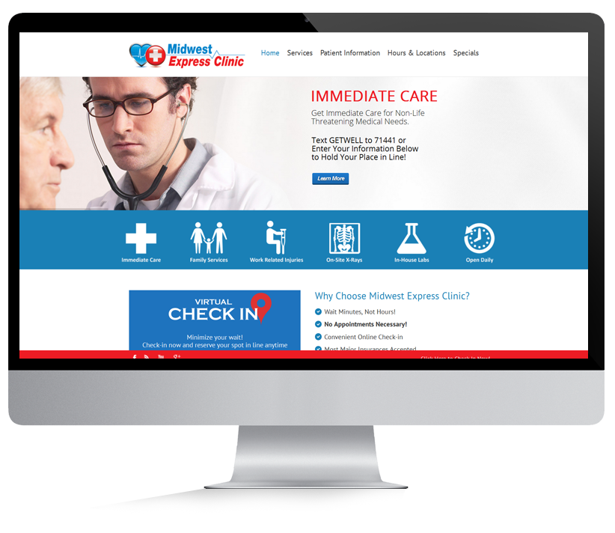
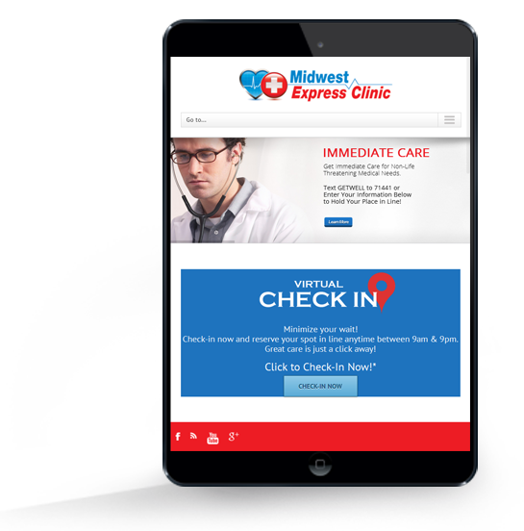
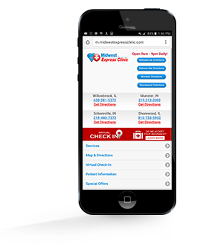
WEBSITE DEVELOPMENT
Make a great first impression online with a professional website
Today’s customers are checking out your business online long before they stop in your store or call to find out more information. Ensure you’re making the right first impression with a professional, device-responsive website or mobile application to engage visitors and turn prospects into leads.
BENEFITS OF RESPONSIVE WEBSITE DESIGNS
Improve your brand image with a professional, informative website
Offer an easy-to-use website experience
Demonstrate your credibility to potential customers by offering engaging and informative content
Reach new customers searching for your product or services online
Sitemap submission to Google, Bing and Yahoo so your website gets properly indexed
Gather valuable data from your visitors or potential customers with intake forms
Basic on-page SEO helps pack your website with relevant keywords to help your website be found easily by consumers in search results

