Slide 1
PREPARED FOR
CLIENT NAME HERE
Proposal Name Here
Month 2020
YOUR LOGO HERE

Slide 2
YOUR LOGO HERE
YOUR GOALS
WHAT WE HEARD FROM YOU

Slide 3

OVERVIEW
YOUR LOGO HERE
Ampliﬁed Digital
We leverage all types of media to develop
an integrated media plan that incorporates print and digital placements to maximize
Budget 1
your ROI. Your success is our #1 priority.
PRODUCTS
$0/mo
For 12 months
Print
High Impact
Box / Banner
Targeted Display
Mobile Location Targeting
Social Ads
Pay-Per- Click
Pre Roll

Slide 4
OVERVIEW
Geography 1
POPULATION
000,000,000
AVG. INCOME
$0,000
MEDIAN AGE
0 years
PEOPLE/HOUSEHOLD
00.0
NUMBER OF BUSINESSES
0
Device Usage
0% | Desktop
0 .0 % | Mobile
0% | Tablet
Source: Name Your Source Here

Slide 5

PRINT

Slide 6
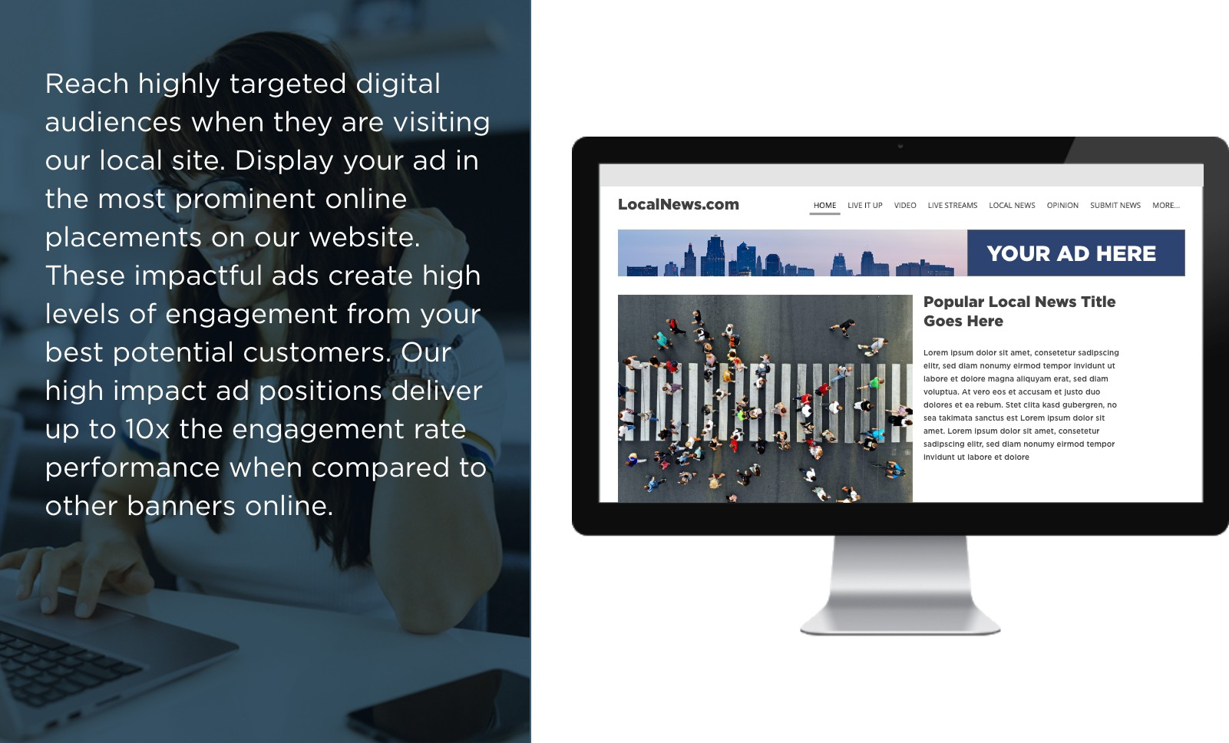
HIGH IMPACT
YOUR LOGO HERE

Slide 7
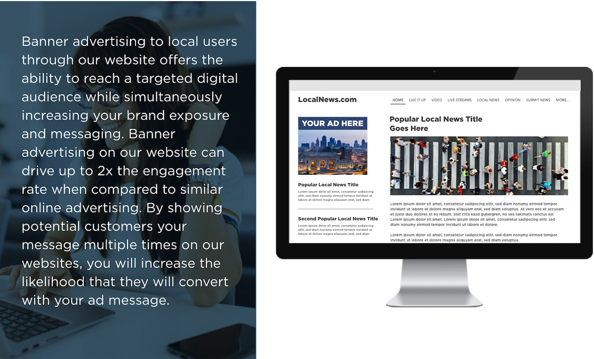
BOX / BANNER
YOUR LOGO HERE

Slide 8
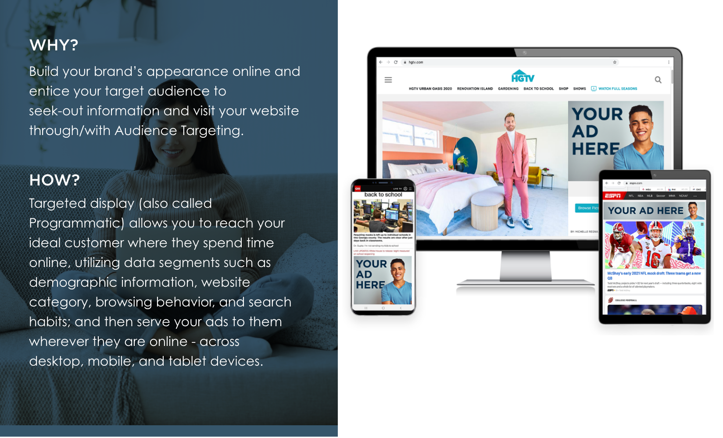
TARGETED DISPLAY
YOUR LOGO HERE

Slide 9


TARGETED DISPLAY & PRE ROLL
YOUR LOGO HERE
TARGET DEMOGRAPHIC
GENDER
ALL
Place your message in front of potential customers where they spend time online, utilizing audience interests, demographic information, and geographic location to target your best possible audience.
AGE
ALL
INCOME
ALL
FAMILY
ALL
EDUCATION
ALL
BUDGET 1
0.0X FREQUENCY
0.0% REACH
REACH & FREQUENCY

Slide 10
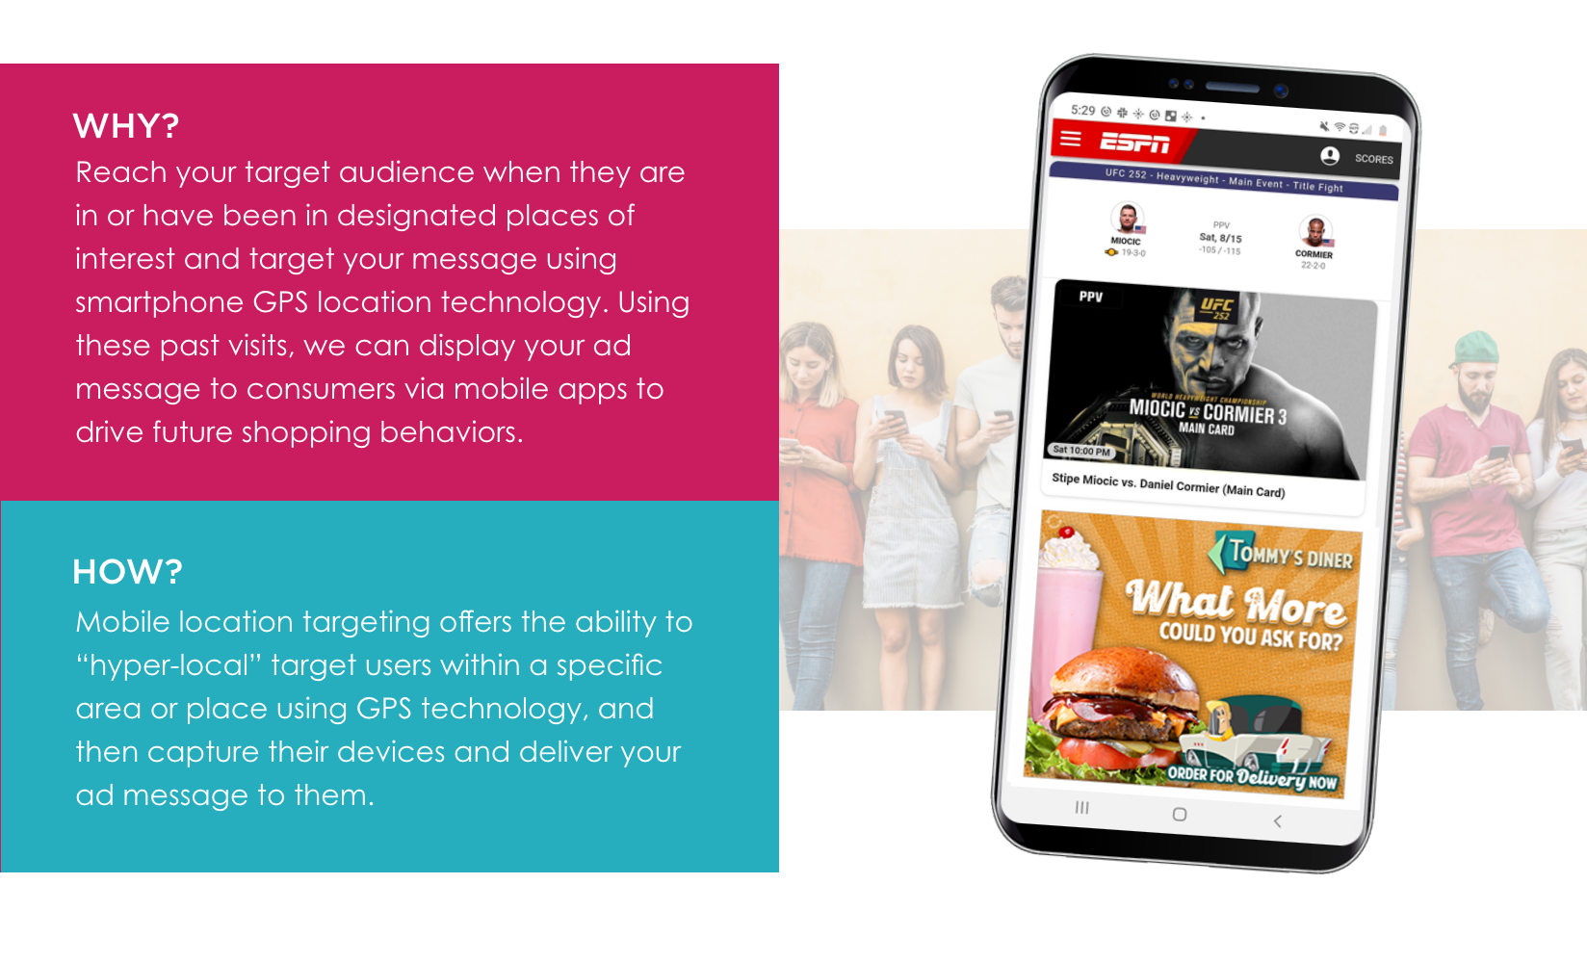
MOBILE LOCATION TARGETING
YOUR LOGO HERE

Slide 11
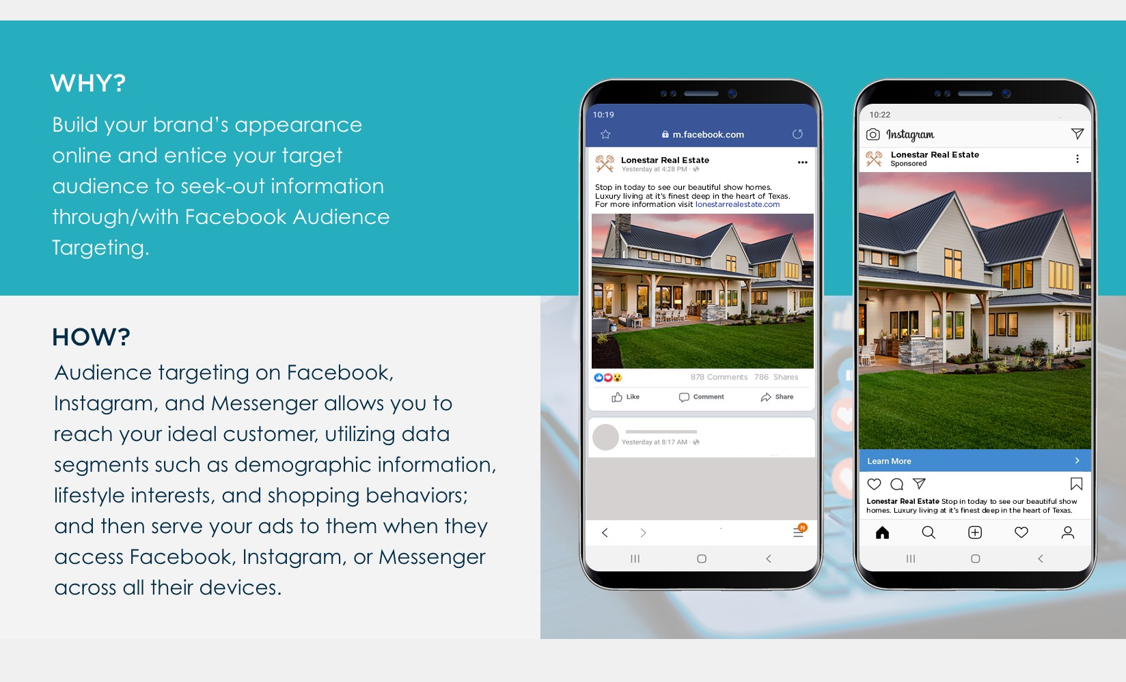
SOCIAL ADS
YOUR LOGO HERE

Slide 12




SOCIAL
YOUR LOGO HERE
TARGET INTERESTS
Target users based on their location, demographic, and interests.
Retarget website visitors and Facebook page visitors
Arts & Entertainment
Autos & Vehicles
Beauty & Fitness
TRANSPARENCY
Performance Reporting by:
Demographic | Geography Creative | Placement | Device
TARGET DEMOGRAPHICS
GENDER
All
AGE
Under 18-34
INCOME
All
FAMILY
All
EDUCATION
All

Slide 13
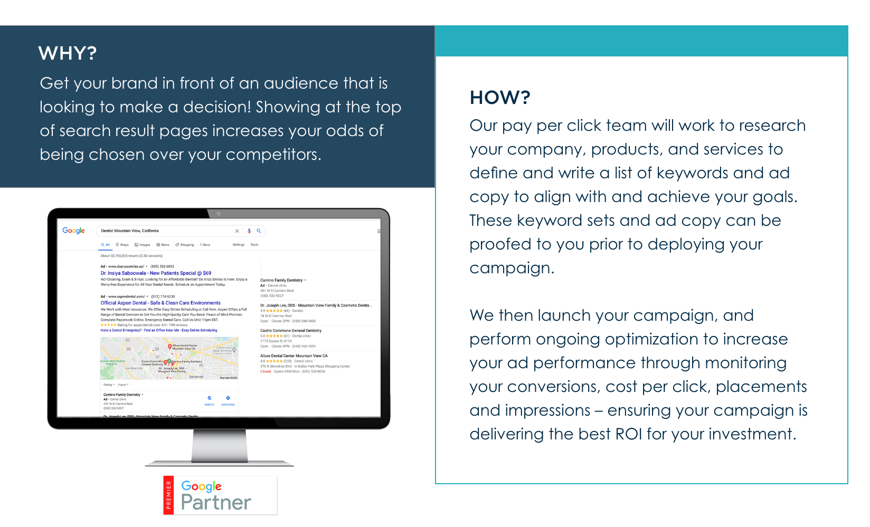
PAY-PER-CLICK
YOUR LOGO HERE

Slide 14
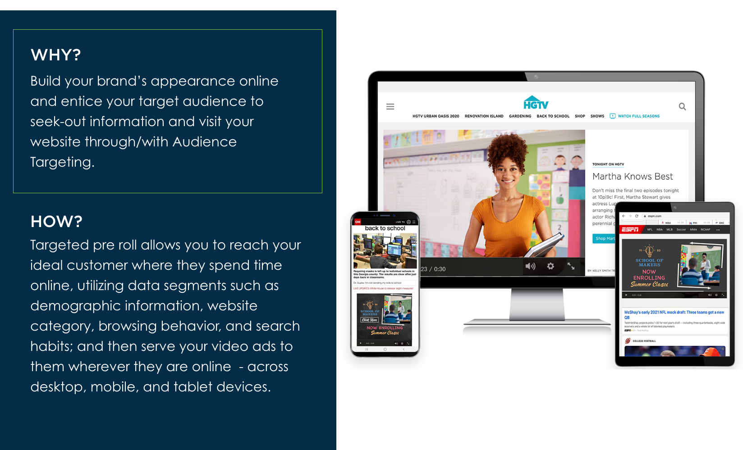
PRE ROLL
YOUR LOGO HERE

Slide 15
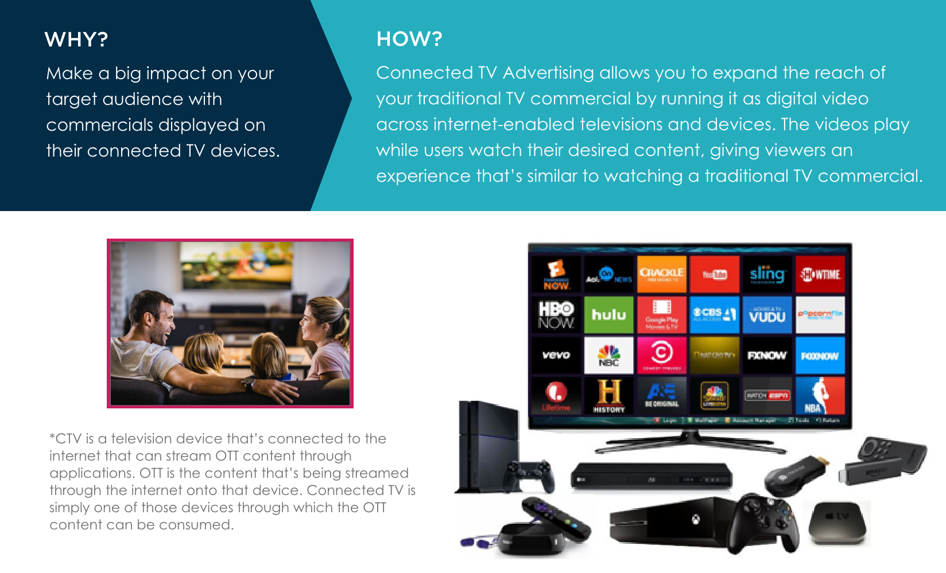
CONNECTED TV (CTV)
YOUR LOGO HERE

Slide 16
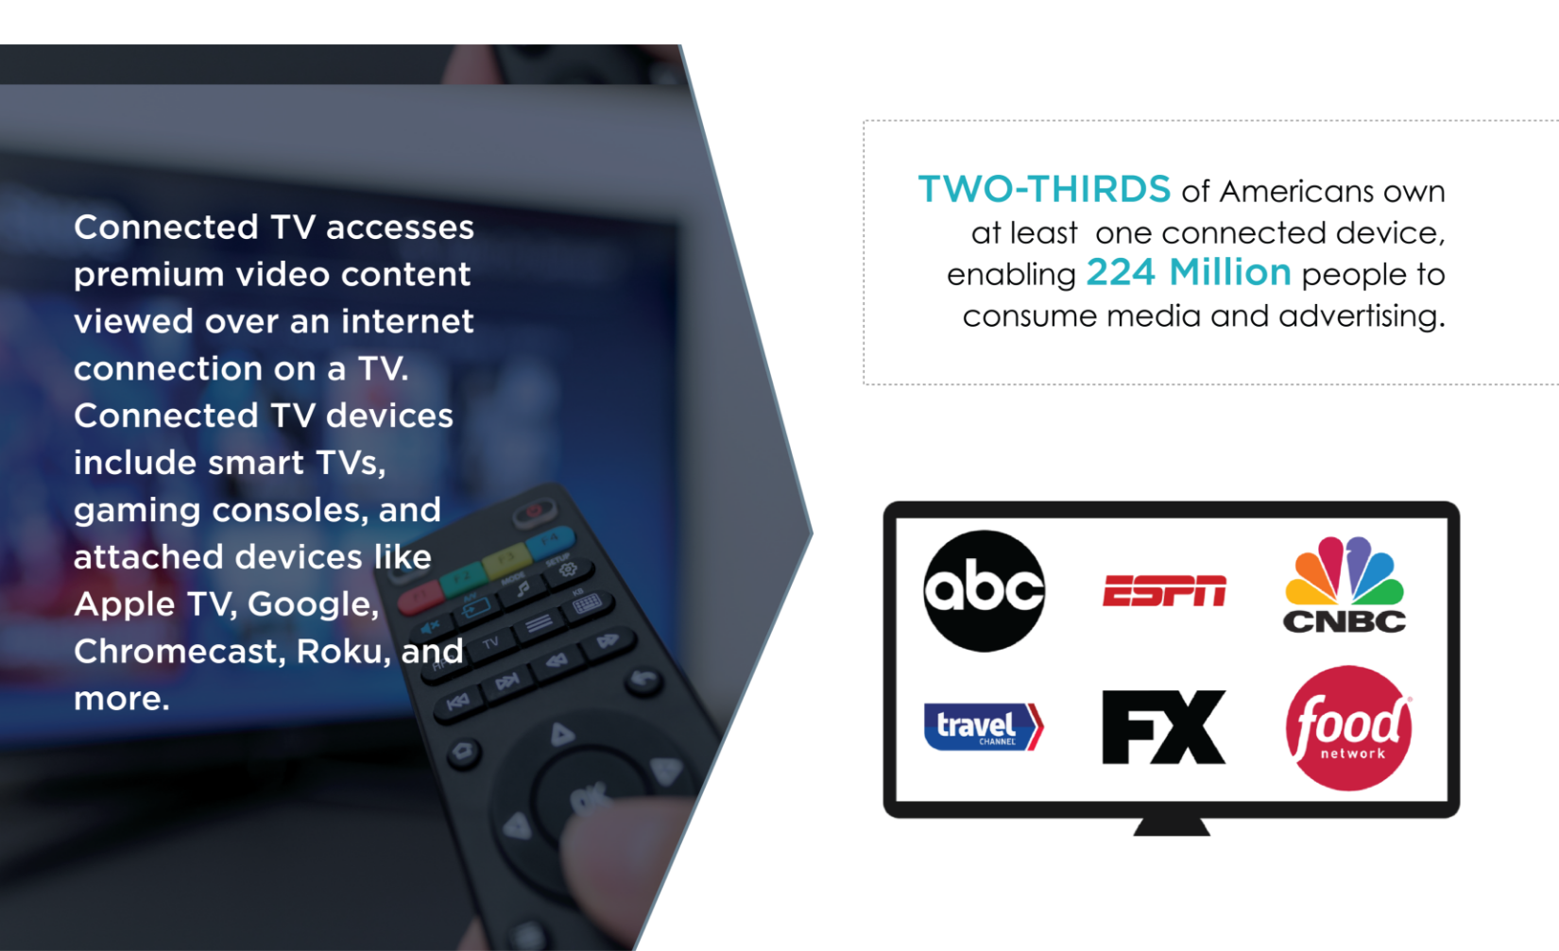
CONNECTED TV
YOUR LOGO HERE

Slide 17
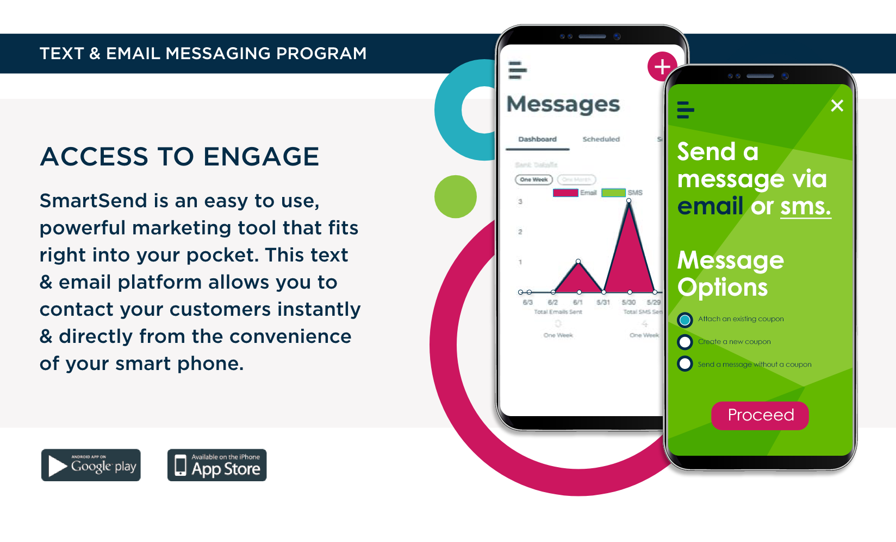
SMARTSEND
YOUR LOGO HERE

Slide 18
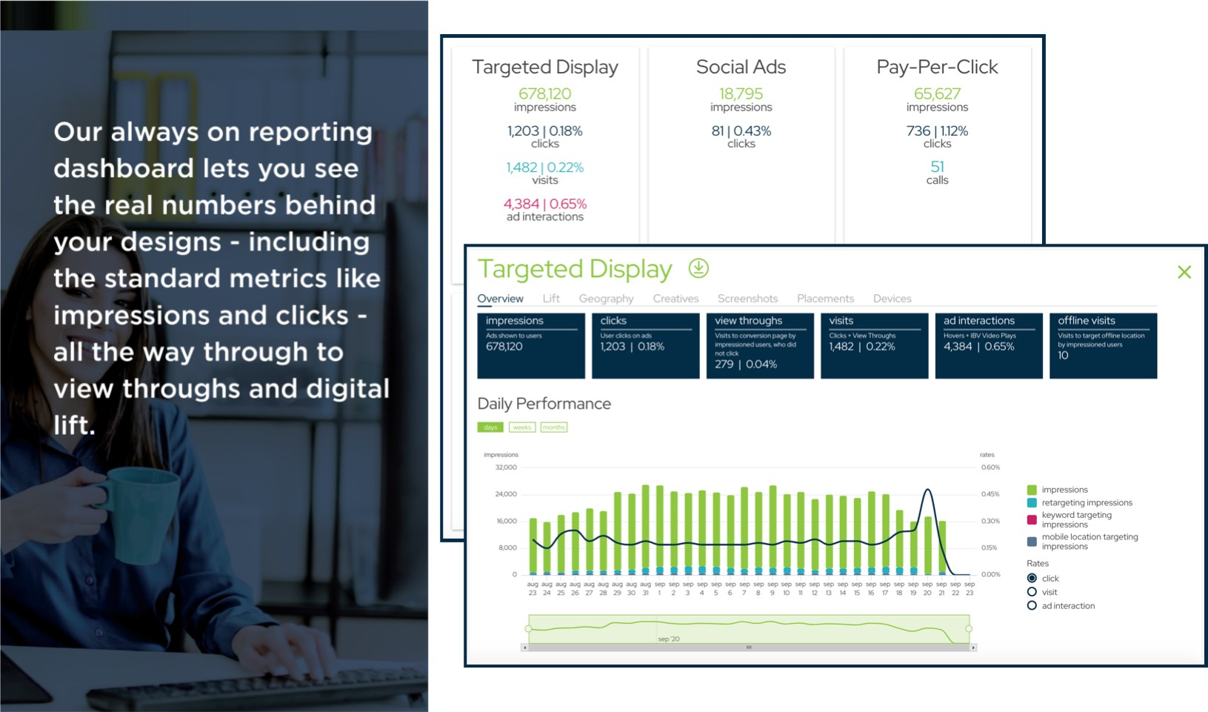
REPORTING DASHBOARD
YOUR LOGO HERE

Slide 19
BUDGET 1
YOUR LOGO HERE
12 MONTHS
Print
High Impact
Box / Banner
Targeted Display
Mobile Location Targeting
Social Ads
Pay-Per-Click
Pre Roll
Connected TV
SmartSend
Recurring Total | $0/Month
PARTNER SIGNATURE DATE ADVERTISER SIGNATURE DATE

